Slide 1


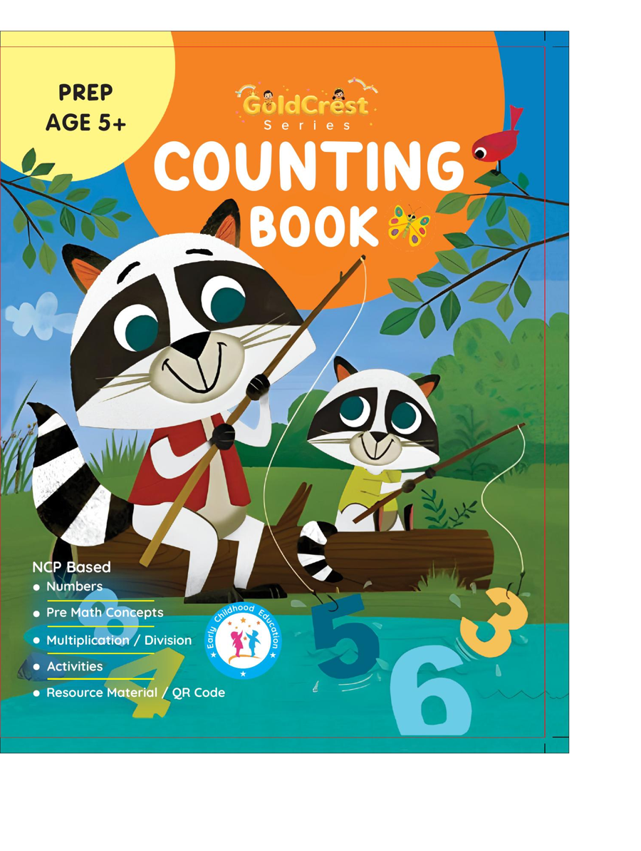
GoldCrest Counting Book
Prep • Age 5+
An activity-based early-years book from the GoldCrest Series.
A Project of Azhar Publishers & Book Factory

Slide 2
i
What's Inside
GoldCrest Counting Book Prep • Age 5+
1
Counting to 50 and number words
2
Before, after and between
3
Greater / less and ordinal numbers
4
4 and 5 times tables
5
Addition, subtraction, × and ÷
6
Money, shapes and math signs

Slide 3
★
Purpose & Classroom Support
Strengthens number operations and problem-solving, preparing children for Grade 1 mathematics.
“
Every book comes with
1
2
3
Teacher's Lesson Plan
Practice Papers
Digital Interactive Version
A 40-week lesson plan that guides teachers, day by day.
Monthly tests and term exam papers for children to attempt.
An interactive flipbook and digital exercises for engaging, screen-based practice.
A Project of Azhar Publishers & Book Factory

